Slide 1
Selenium Course Session 5

Slide 2
Window Handle
Window Handle is a Unique identifier of the browser tab.
Syntax:
String handle = driver.getWindowHandle()
- It returns a handle of the current page/tab
Set <String> handles = driver.getWindowHandles()
- It returns a set of handles of the all the pages available
Advance For Loop/For Each Loop:
for(String i : driver.getWindowHandles()) {
driver.switchTo().window(i);
}

Slide 3
TestNG
Automation testing framework inspired by JUnit
NG - stands for Next Generation
Generate a proper report (number of test cases run, passed, failed, or skipped)
Emailable and HTML format of report
Multiple test cases can be grouped in testng.xml file setting priorities on which should run first
Execute failed test cases separately through testng-failed.xml file
Ease of integration with Maven and Jenkins
Test cases can be grouped and parallely tested unlike JUnit

Slide 4
Annotations
Lines of code controlling how the method will execute
Always preceded by @ symbol
@Test - Method executed alphabetically
@Test(priority=1) - Executed lowest to highest
@Test(priority=1, alwaysRun = true)
@BeforeTest - Executed prior to first test case
@AfterTest - Executed after all test cases have executed
@BeforeMethod - Executed prior to each method/Test Case
@AfterMethod - Executed after each test case

Slide 5
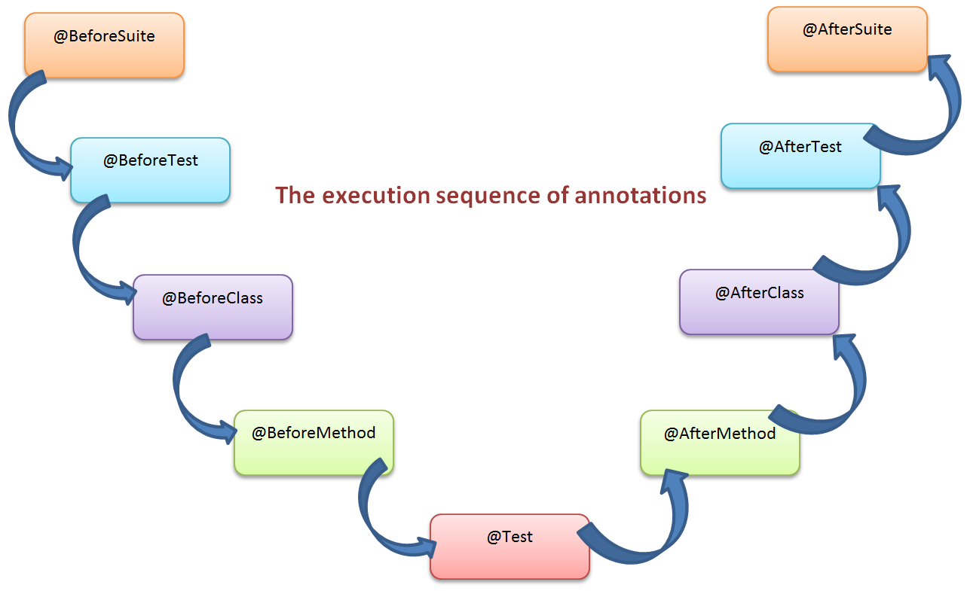
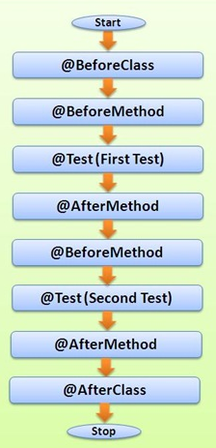
Execution Sequence

Slide 6
Interview Questions
How to switch driver between windows?
What are the advantages of TestNG?
Explain the sequence of TestNG Annotations.
How to set test case priority in TestNG?

